Slide 1
WELCOME TO OUR PRESENTATION

Slide 2

Predict behavior to retain cutomers

Slide 3
GROUP MEMBERS
Name ID
Phal Davy e20201437
Ngeav Bonat e20201691
Chhon Chaina e20200934
Set Sophy e20201576
Hun Sokrarith e20201218
Ya Manon e20200745

Slide 4
Table Of Content
01
Introduction
07
02
Exploratory Data Analysis
08
03
Model Building
09
04
Model Evaluation
10

Slide 5

Introduction
The Telco customer churn data contains information about a fictional telco company that provided home phone and Internet services to 7043(7043,21) customers in California. It indicates which customers have left, stayed, or signed up for their service.

Slide 6
Our Company
The TELECOM company that provided home phone and Internet services.

Slide 7








CUSTOMER IN THE COMPANY
Gender
Senior Centizen
Partner
Dependents
#01
#02
#03
#04

Slide 8
2. Exploratory Data Analysis

Slide 9
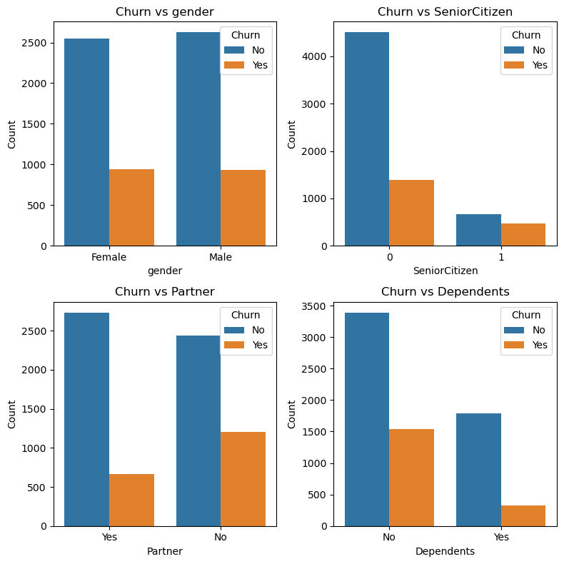
Distribution of Churn vs Customer
Gender has no influence on whether the customer will churn or not.
Non-senior citizens churn more than non-senior in absolute term but in relative term senior citizens churn more often.
Customers without partner churn more often than their counterparts.
Customers without dependents churn more than customers with dependents.

Slide 10
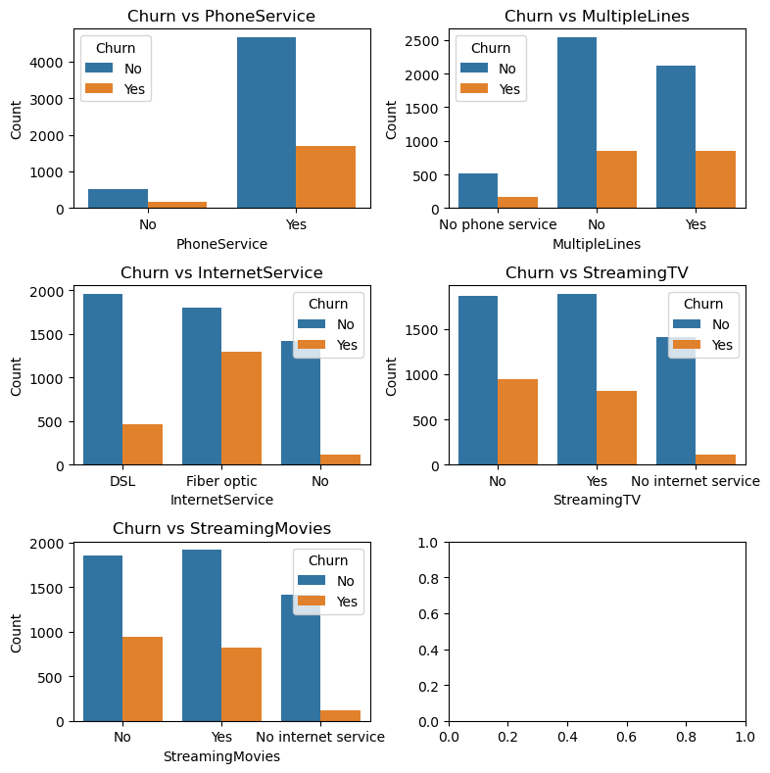
Distribution of Churn vs Services
Streaming TV, Streaming Movies, Multiple Lines have no impact on churn rate.
Customers who have fiber optic tend to churn significantly more than ones that have DSL.

Slide 11
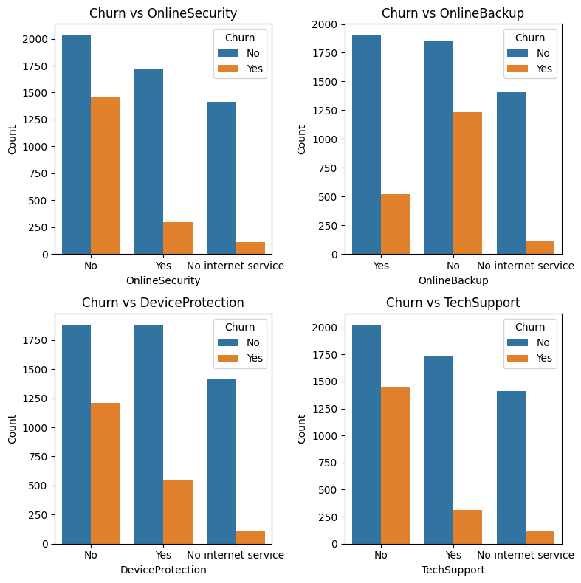
Distribution of Churn vs Security Support

Slide 12
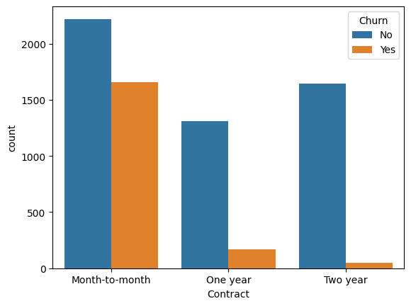
Distribution of Churn vs Contract type
Customer with Month-to-Month contracts tend to churn significantly more often then customers with one year and two year contracts

Slide 13
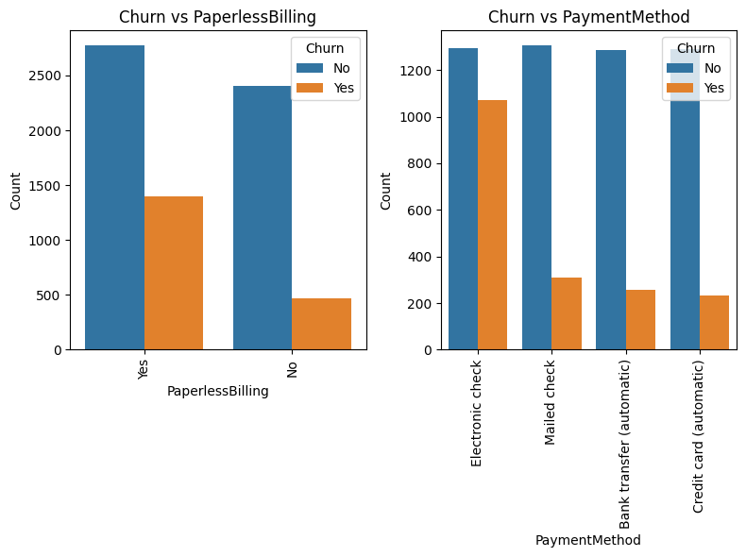
Distribution of Churn vs Payment Options

Slide 14
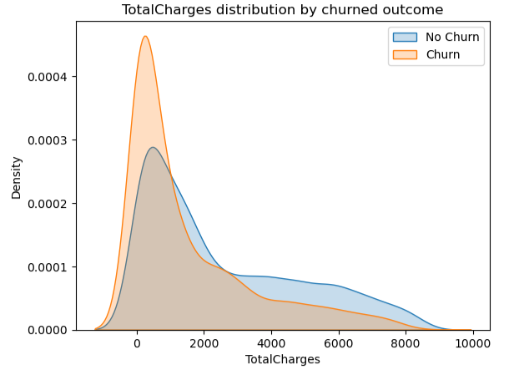
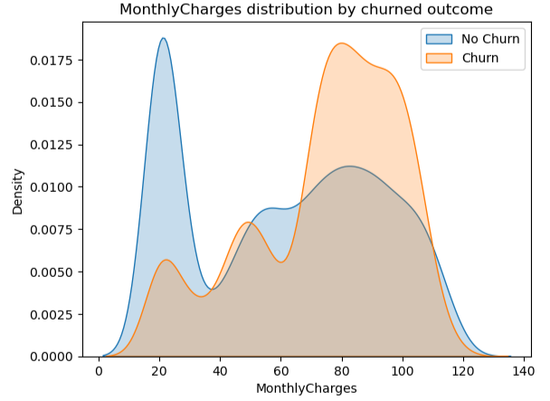

Slide 15
3. Model Building

Slide 16
Recursive Feature Elemination (RFE)
There are 26 features but we select only 15 features to get the best model.
Accuracy: 0.7963094393
Error: 0.2036905606
Precision: 0.8396396396
Recall: 0.8396396396
Specficity: 0.6354515050
F1: 0.8665736866

Slide 17
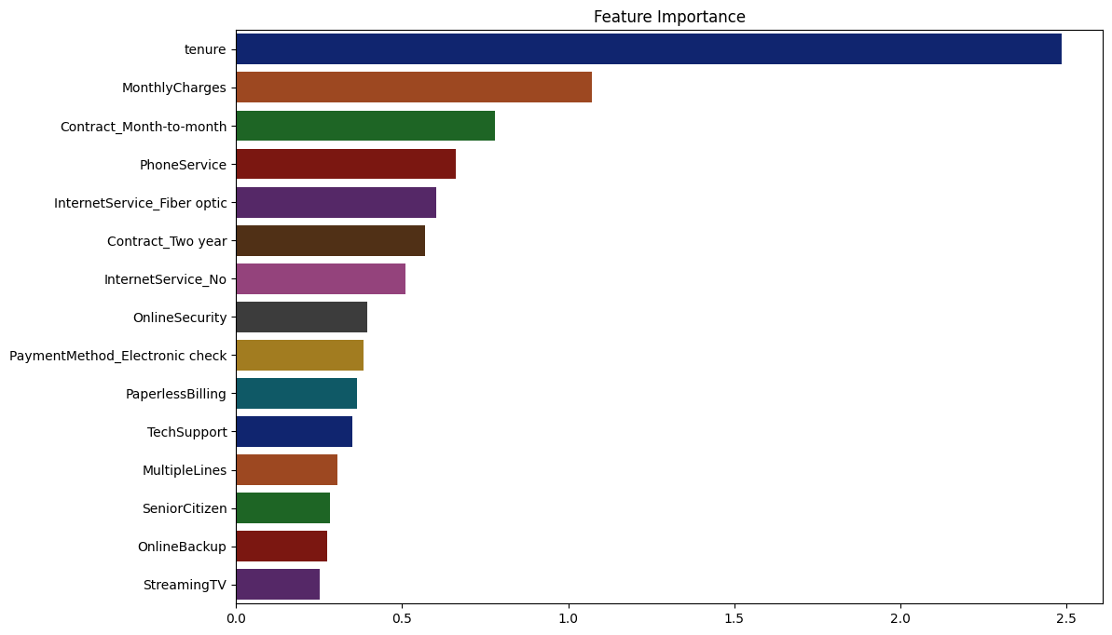
Feature Selection
Tenure is the most important feature:

Slide 18
L1 Regularization
We use this method to prevent overfitting .....
Accuracy: 0.8019872249
Error: 0.1980127750
Precision: 0.9068203650
Recall: 0.8383658969
Specficity: 0.6572438162
F1: 0.8712505768

Slide 19
4. Model Evaluation

Slide 20
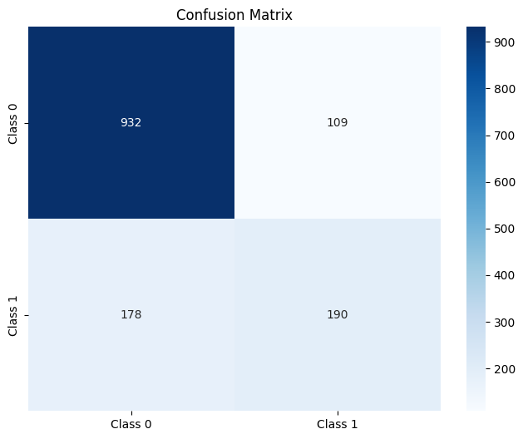
Result for 26 features...

Slide 21

Result after implement L1 regularization.....

Slide 22


